Slide 1
Types of Division
A supplemental lesson for AP CSP

Slide 2
Doing math in Python
Python contains several built-in math functions.
You have used some of these functions in your code:
  abs()
  round()
Some other built-in functions include:
  max()
  min()

Slide 3
Doing math in Python
Python follows the order of operations in math
Multiplication and division have a higher precedence than addition and subtraction.
Python has more than one way to divide numbers.
Let’s take a look
  Look at the division problems on the next slide.
  Fill in the mathematical operator for each equation.

Slide 4
Part 1: The Answers Are …
7 ░ 4 = 1.75 7 ░ 4 = 1 | 5 ░ 3 = 1.667 5 ░ 3 = 1
13 ░ 5 = 2.6 13 ░ 5 = 2 | 9 ░ 2 = 4.5 9 ░ 2 = 4

Slide 5
Types of Division
A single / is decimal division
Two // is integer division
// gives the whole number only in the division problem
Examples:
  8 / 4 = 2.0
  8 // 4 = 2
  6 / 5 = 1.2
  6 // 5 = 1
  5 / 6 = .83
  5 // 6 = 0
1
4⟌7
7 // 4 = 1

Slide 6
Part 2: The Answers Are …
7 / 4 = 1.75 7 // 4 = 1 7 ░ 4 = 3 | 5 / 3 = 1.667 5 // 3 = 1 5 ░ 3 = 2
13 / 5 = 2.6 13 // 5 = 2 13 ░ 5 = 3 | 9 / 2 = 4.5 9 // 2 = 4 9 ░ 2 = 1

Slide 7
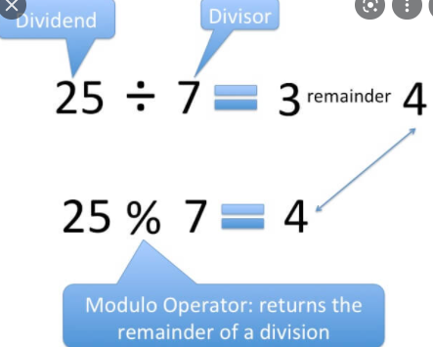
Modulo Division
% gives the remainder of integer division
r 3
1
4⟌7
7 % 4 = 3

Slide 8
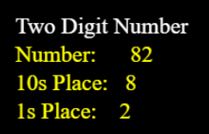
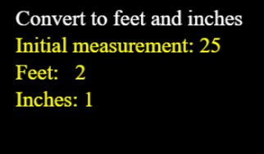
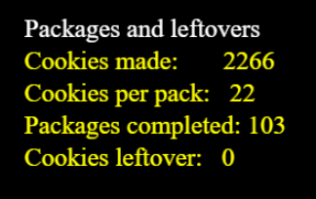
Modulo division
Limits the number of possible answers
  Any_number % 3 can only be 0, 1, or 2
Lets you separate place values of numbers
Is used for numerical conversions
Gives you “leftovers”
And much, much more!

Slide 9
Part 3: Check your understanding
Given: number % 10 What are the possible answers? | Given: number % 5 What are the possible answers? | Given: number % 3 What are the possible answers?

Slide 10
Part 3: Check your understanding
Given: number % 10 What are the possible answers? 0, 1, 2, 3, 4, 5, 6, 7, 8, 9 | Given: number % 5 What are the possible answers? 0, 1, 2, 3, 4 | Given: number % 3 What are the possible answers? 0, 1, 2

Slide 11
Part 3: Check your understanding
Evaluate: 10 // 7 = 10 % 7 = | Evaluate: 10 // 3 = 10 % 3 = | Evaluate: 9 // 6 = 9 % 6 =

Slide 12
Part 3: Check your understanding
Evaluate: 10 // 7 = 1 10 % 7 = 3 | Evaluate: 10 // 3 = 3 10 % 3 = 1 | Evaluate: 9 // 6 = 1 9 % 6 = 3

Slide 13
Part 3: Check your understanding
Evaluate: 10 // 5 = 10 % 5 = | Evaluate: 4 // 5 = 4 % 5 = | Evaluate: 1 // 2 = 1 % 2 =

Slide 14
Part 3: Check your understanding
Evaluate: 10 // 5 = 2 10 % 5 = 0 | Evaluate: 4 // 5 = 0 4 % 5 = 4 | Evaluate: 1 // 2 = 0 1 % 2 = 1

